Slide 1
Computing and SE II
Chapter 16: Design Patterns
Software Institute, NJU

Slide 2
Main Contents
Design Pattern Introduction
Information Hiding AND Strategy
Object Creation AND Factory, Factory Method, Abstract Factory, Singleton
Programming to Interface AND Iterator

Slide 3
Design Patterns Introduction
—— Why?
Designing OO software is hard
Designing reusable OO software – harder
Experienced OO designers make good design
New designers tend to fall back on non-OO techniques used before
Experienced designers know something – what is it?
Notes:
Introduction to Software Engineering
Design Patterns

Slide 4
Design Patterns Introduction
—— Why?
Expert designers know not to solve every problem from first principles
They reuse solutions
These patterns make OO designs more flexible, elegant, and ultimately reusable
Notes:
Introduction to Software Engineering
Design Patterns

Slide 5
设计模式
“设计模式描述了一个在我们周围不断重复发生的问题，以及该问题的解决方案的核心”
Christopher Alexander，《建筑的永恒之道》
是经过实践反复检验、能解决关键技术难题、有广泛应用前景和能够显著提高软件质量的有效设计经验总结

Slide 6
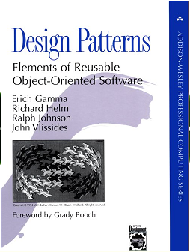
What is a Design Pattern?
A design pattern
  abstracts a recurring design structure
  comprises class and/or object
    dependencies,
    structures,
    interactions, or
    conventions
  distills design experience

Slide 7
Elements of Design Patterns
Design patterns have 4 essential elements:
  Pattern name: increases vocabulary of designers
  Problem: intent, context, when to apply
  Solution: UML-like structure, abstract code, responsibility, collaboration
  Consequences: results and tradeoffs

Slide 8
Main Contents
Design Pattern Introduction
Information Hiding AND Strategy
Object Creation AND Factory, Factory Method, Abstract Factory, Singleton
Programming to Interface AND Iterator

Slide 9
Information Hiding(1)
Each module hides the implementation of an important design decision so that only the constituents of that module know the details

Slide 10
Information Hiding(2)
Modules may have additional secrets: Changes
Anticipate changes
  You then separate each design secret by assigning it to its own class, subroutine, or other design unit.
  Next you isolate (encapsulate) each secret so that if it does change, the change doesn’t affect the rest of the program.

Slide 11

Intersection Traffic Lights Control
The light- switching policy changes by the hour
The “dumb” policy: change the green route every 5 seconds
Midnight policy: change to yellow always
Rush hour policy: double the “green time” in the busy route

Slide 12
A Bad Solution
Use multiple conditional statement to set the behavior according to current policy
intersection::next_green(the_green_route r)
{
switch (current_policy) {
case dumb: next_time := time + constant_time;
case midnight: if (not the_green_route.is_busy)
then …
case rush_hour: …
}
}

Slide 13
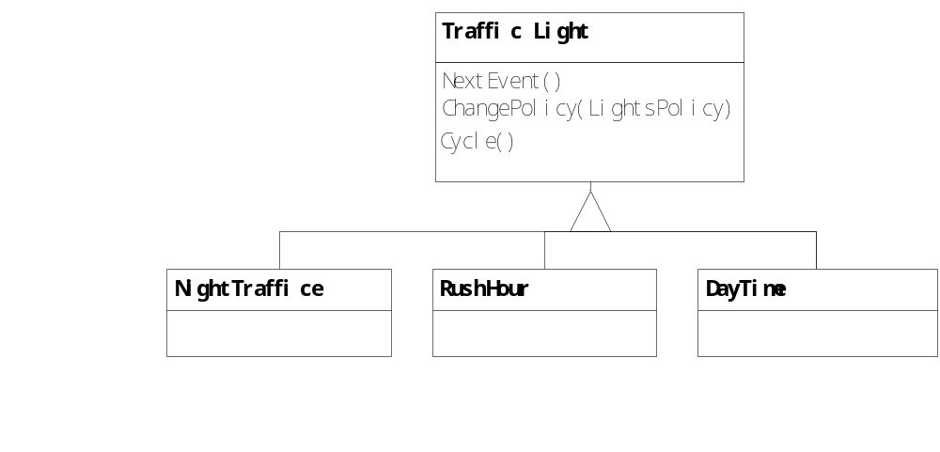
Better, but not enough
Plan the change

Slide 14
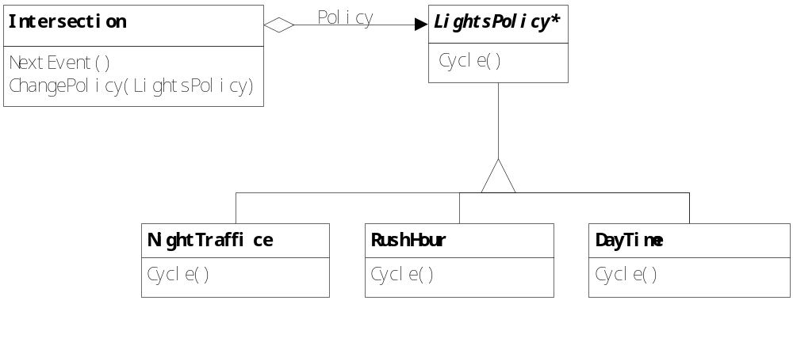
Strategy Pattern
—— Traffic Lights Management

Slide 15
Strategy Pattern
——Problem
Use the Strategy pattern when
  many related classes differ only in their behavior. Strategies provide a way to configure a class with one of many behaviors
  a class defines many behaviors, and these appear as multiple conditional statements in its operations
  you need different variants of algorithm
  an algorithms uses data that client shouldn’t know about

Slide 16
Strategy Pattern
—— STRATEGY Solution
Context
strategy
Strategy
ContextInterface()
AlgorithmInterface()
ConcreteStrategyA
ConcreteStrategyB
AlgorithmInterface()
AlgorithmInterface()

Slide 17
Strategy Pattern
—— STRATEGY - Consequences
Changeability and Reusability
  Families of related algorithms for extend
  An alternative to sub-classing
    you can subclass Context class directly to give it different behaviors
Complex for comprehension
  Good: Strategies eliminate conditional statements
  Bad: Logic is separated, Clients must be aware of different Strategies
    a client must understand how strategies differ before it can select the appropriate one

Slide 18
Strategy Pattern
—— STRATEGY -Summary
If there are complex and vary algorithms, then there may be Strategy Pattern
If there is a changeable behavior in some fixed characteristics, then there may be Strategy Pattern
If there are complex conditional statements, then there may be Strategy Pattern

Slide 19
典型问题
在一个大规模的连锁超市中雇员的薪水支付可以分为很多种。其中雇员的薪酬支付方式和支付频率就有好几种：
  有些雇员是钟点工，按时薪来支付。薪水=时薪*工作小时数。每周三支付。
  有些雇员按月薪支付。薪水=固定月薪。每月21日支付。
  有些雇员是提成制。薪水=销售额*提成比率。每隔一周的周三支付。

Slide 20
class PaymentStrategy{ //拥有每个雇员的支付相关的数据 ArrayList<DOUBLE> hourList = new ArrayList< DOUBLE >(); ArrayList< DOUBLE > hourRateList = new ArrayList< DOUBLE >(); ArrayList< DOUBLE > contractValueList = new ArrayList< DOUBLE >(); ArrayList< DOUBLE > commissionRateList = new ArrayList< DOUBLE >(); … //计算需要支付的金额 public double calculatePayment(int employeeID){ switch(e.getPaymentClassification()){ case HOURLY: return hourList.get (employeeID)* hourRateList.get (emplyeeID); break; case COMMISSIONED: return contractValueList.get (employeeID)* commissionRateList.get (emplyeeID); break; case SALARIED: … } } public boolean isPayDay(int employeeID){ switch(e.getPaymentSchedule()){ case MONTHLY: … case WEEKLY: … case BIWEEKLY: … } } }
最糟糕的实现：Conditional Statement

Slide 21
潜在的变化
钟点工可能两星期支付一次；
  (M)实现的可修改性
现在是时薪以后可能会变为月薪；
  (C)实现的灵活性
也有可能出现新的薪水支付方式和支付频率。
  (E)实现的可扩展性

Slide 22
Secret 分析
Payment
  需求：支付功能
  变更1：支付方式
  变更2：支付频率

Slide 23
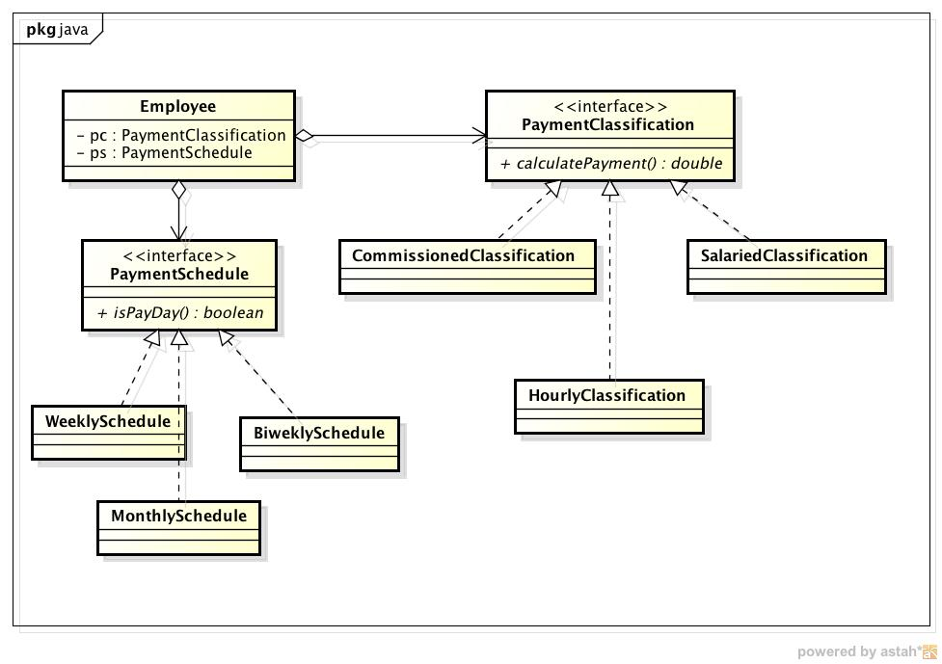
案例：策略模式实现

Slide 24
策略模式深入分析
可变更：信息隐藏
（M）实现的可修改性
  对已有实现的修改
  例如：修改现有促销策略
（E）实现的可扩展性
  对新的实现的扩展
  例如：增加一条新的促销策略
（C）实现的灵活性
  对实现的动态配置
  例如：通过修改数据或配置更改某商品对应促销策略

Slide 25
如何实现可修改性、可扩展性、灵活性？
可修改性、可扩展性
  符合DIP原则的抽象类（继承）机制
    通过定义抽象类与继承（实现）它的子类强制性地做到：接口与实现的分离，进而实现上述质量
      强制性地使用抽象类起到接口的作用
      强制性地使用子类起到实现的作用
灵活性
  组合（委托）机制
    动态调整所委托的类，实现灵活性

Slide 26
使用Interface的抽象类机制
public interface Interface_A { // 接口 public void method_A(); }
interface 定义了接口
Class是接口的实现
public class Class_A1 implements Interface_A { public void method_A(){ // 实现 System.out.println(“Class_A1 ‘s method_A()!”); } }

Slide 27
使用继承的抽象类机制
“父类”起到接口的作用
  父类定义的接口规约比其实现代码更加重要
“子类”是对父类所定义接口规约的实现
  子类所继承的父类实现代码不会扮演关键作用
public class Super_A{ public void method_A(){ // 父类的接口和父类的实现 System.out.println(“Super_A ‘s method_A()!”); }
public class Sub_A1 extends Super_A{ public void method_A(){ // 子类的实现 System.out.println(“Sub_A ‘s method_A()!”); } }

Slide 28
利用抽象类机制实现可修改性和可扩展性
只要方法的接口保持不变，方法的实现代码是比较容易修改的，不会产生连锁反应
通过简单修改创建新类的代码，就可以相当容易地做到扩展新的需求（不用修改大量与类方法调用相关的代码

Slide 29
利用委托机制实现灵活性
继承的缺陷：一旦一个对象被创建完成，它的类型就无法改变，这使得单纯利用继承机制无法实现灵活性（类型的动态改变）
利用组合（委托）机制可以解决这个问题

Slide 30
只需要调整Frontend的委托类（Backend），就可以实现Client与Backend之间的灵活性
class Backend{ public int method_2(){ } }
class Frontend{ public Backend back = new Backend(); public int method_2(){ back.method_2(); } }
class Client{ public static void main(String[] args){ Frontend front = new Frontend(); int i = front.method_2(); } }

Slide 31
更好的灵活性实现方案
委托与抽象类机制的结合
Client
Frontend
Backend
Interface
Backend

Slide 32
Strategy体现的设计原则？
SRP
  将变化与需求职责分离
Favorite Composition over Inheritance
  实现灵活性
OCP，LSP，DIP
  将可修改和可扩展都统一为可扩展
可能会违反：To be Explicit
  如果由client来决定algorithm的创建，那么Context将不再能明确algorithm细节
    可变更性的必要代价

Slide 33
Main Contents
Design Pattern Introduction
Information Hiding AND Strategy
Object Creation AND Factory, Factory Method, Abstract Factory, Singleton
Programming to Interface AND Iterator

Slide 34
OO的对象创建与撤销问题
类型的创建与销毁 VS 对象的创建与销毁？
  声明即创建 主动创建
  生命周期结束 不再被需要时
  自动销毁 主动销毁
为解决对象销毁问题，需要垃圾收集机制
解决对象创建问题，完全依赖程序员！
  依赖于很多具体方法的使用
    单件模式、工厂、工厂方法、抽象工厂
    原型模式、代理模式（虚拟创建）、容器

Slide 35
Object creation: Simple
  Creational connections with others
  Unlimited instances
  Creating one type
  Simple instantiation and initialization
  Methods：Creator Pattern
  高内聚、低耦合
    如果在A的所有关联类中,B和A具有最强的耦合，那么优先选择让B 创建A
    创建关系也是一种耦合，强度类似于 聚集耦合

Slide 36
Object creation: Complex (1)
Limited instances
Scenario 1: only one instance permitted
Pattern: Singleton
  problem: sometimes we will really only ever need one instance of a particular class
    examples: keyboard reader, bank data collection
    we'd like to make it illegal to have more than one, just for safety's sake

Slide 37
Singleton: structure
Singleton
-static uniqueInstance
-…
+static getinstance()
-singleton()
return uniqueInstance
+…

Slide 38
Implementing Singleton
make constructor(s) private so that they can not be called from outside
declare a single static private instance of the class
write a public getInstance() or similar method that allows access to the single instance
  possibly protect / synchronize this method to ensure that it will work in a multi-threaded program

Slide 39
Singleton example
consider a singleton class RandomGenerator that generates random numbers
public class RandomGenerator {
private static RandomGenerator gen;
public static RandomGenerator getInstance() {
if (gen == null)
gen = new RandomGenerator();
return gen;
}
private RandomGenerator() {}
public double nextNumber() {
return Math.random();
}
}

Slide 40
Singleton模式体现了哪些思想？
封装(信息隐藏：外部抽象与内部结构)
  Principle#1 最小化访问
实现软件需求需要的是“对象创建方法”，不是“构造方法”
  如果“构造方法”与“对象创建方法”效果相同，可以直接替代
  如果“构造方法”与“对象创建方法”效果不同，需要将“对象创建方法”作为外部表现，并加工“构造方法”以实现内部结构
操作符重载？
有没有违反： Global Variables Consider Harmful？

Slide 41
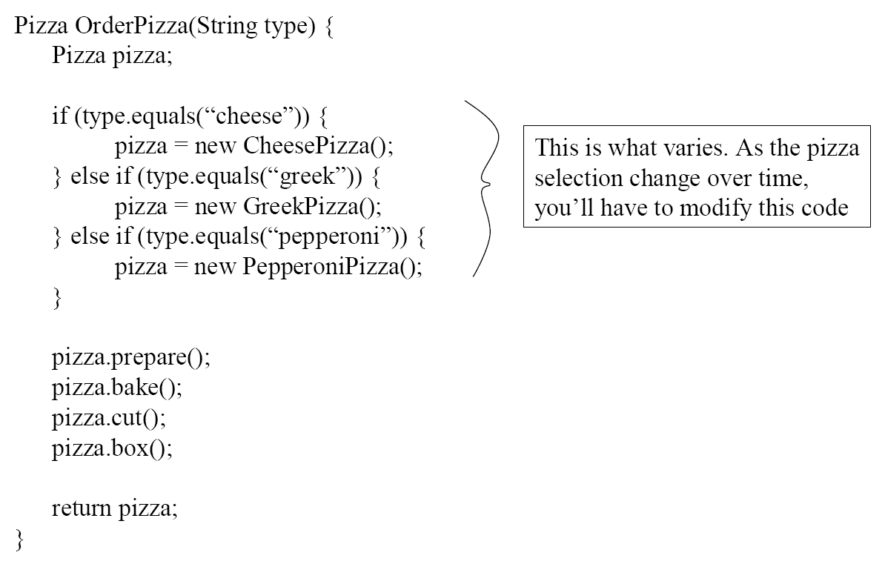
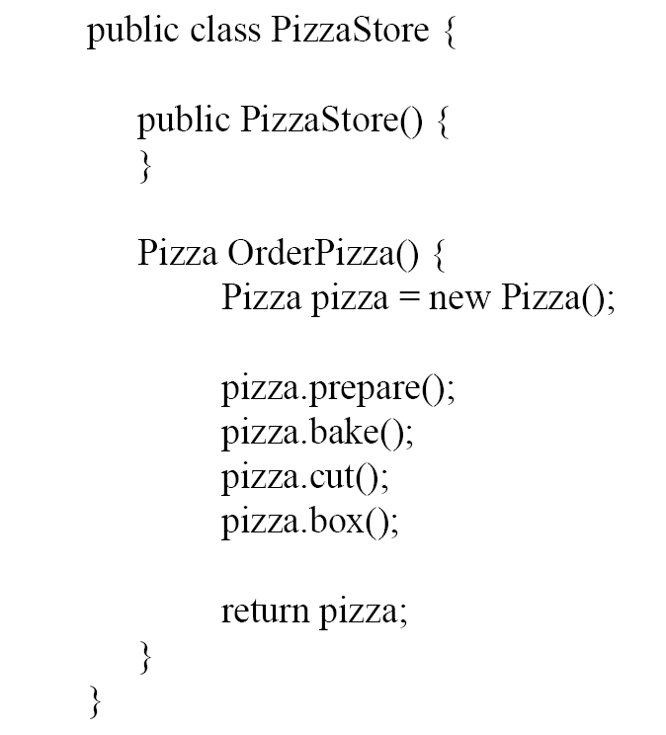
Object creation: Complex (2)
Scenario 2: type variations
需要改进吗？

Slide 42
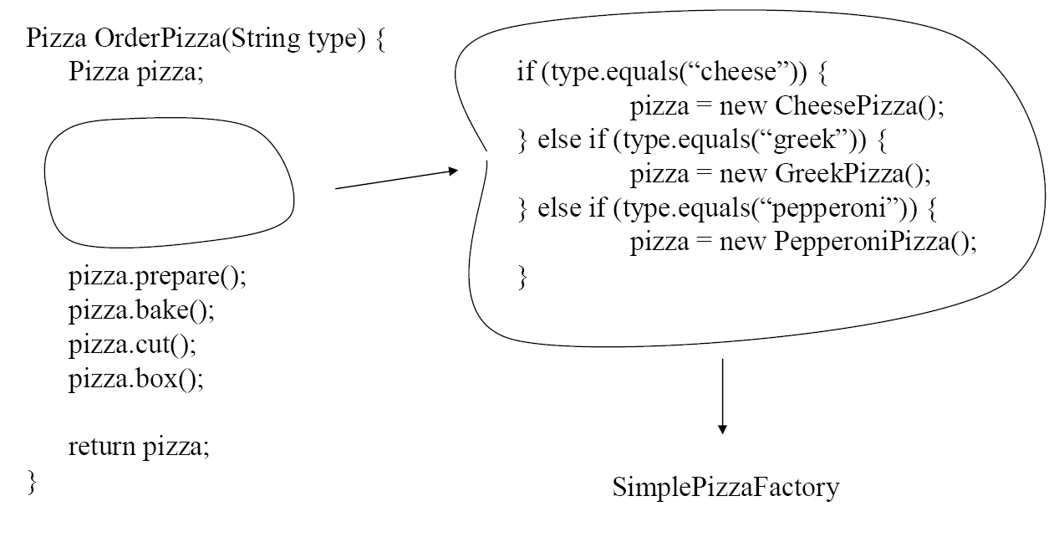
Encapsulating object creation

Slide 43
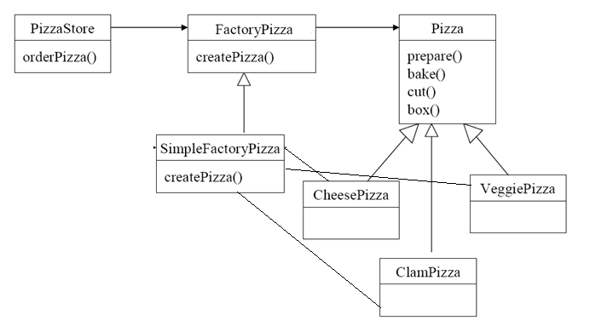
Factory
Factory: a class which’s responsibility is to creating other class with vary types

Slide 44
Factory体现了哪些思想？
Do not repeat！
封装（信息隐藏）：将对象创建抽象为单独职责，并隐藏创建细节
  有利于对象创建的变更
特别是Conditional Statements

Slide 45
A More complex scenario: type variations
Document
Application
docs
save()
Document doc = new Document();
newDocument()
docs.add(doc);
print()
openDocument()
doc.open();
MyApplication
MyDocument
creates
Application class is responsible for creation (and management) of Documents
Problem:
  Application class knows: WHEN a new document should be created
  Application class doesn’t know: WHAT KIND of document to create

Slide 46
A More complex scenario: type variations
Solution:
  Application defines a virtual function, createDocument()
  MyApplication makes sure that createDocument() will create a product (Document) of the correct type.
Document
Application
docs
save()
createDocument()
Document doc = createDocument();
print()
newDocument()
docs.add(doc);
openDocument()
doc.open();
MyApplication
MyDocument
createDocument()
return new MyDocument()
creates

Slide 47
Factory Method: intent
Define an interface for creating an object (replace construction method), but let subclasses decide which class to instantiate.
Lets a class defer instantiation to subclasses.
Factory method is not a simple factory!
Factory method = A method like factory

Slide 48
Factory Method: structure
Creator
...
Product
factoryMethod()
product= factoryMethod()
AnOperation()
...
ConcreteProduct
ConcreteCreator
factoryMethod()
return new ConcreteProduct
creates

Slide 49
Factory Method: Consequences
Changeability , Reusability
  Concrete (Dynamic) types are isolated from the client code
  Provides hooks for subclasses: the factory method gives subclasses a hook for providing an extended version of an object
  Connects parallel class hierarchies: a clients can use factory methods to create a parallel class hierarchy
Complex
  Clients might have to subclass the Creator class just to create a particular ConcreteProduct object

Slide 50
Factory Method体现了哪些思想？
封装（职责抽象）
  区分“对象创建方法”与“构造方法”
通过将“对象创建方法”外置（置入Client继承结构中），实现了“对象创建”的多态
  DIP, LSP, OCP

Slide 51
Factory Method与Factory的关键区别在哪里？
创建方法的 执行时机 与 创建类型信息 是否统一！
统一的时候使用Factory
  此时的创建方法不需要多态
不统一的时候使用Factory Method
  此时的创建方法需要多态

Slide 52
对象创建的更复杂问题（1）
而在软件系统中，经常面临着“多种差异对象”的创建工作。
比如汽车由引擎、轮胎、车身、车门等各部件组成。而每一部件都有很多种。
如何解决该创建问题？
  超级工厂？

Slide 53
CarFactory {
    CarBody creatCarBody (int cbtype){
    choose case cbtype
    case 1: return new CarBody1(); break；
    …
    }
    Engine creatEngine(int etype){
    choose case etype
    case 1: return new Engine1();
    break;
    …
    }
    ….
    }

Slide 54
对象创建的更复杂问题（2）
而在软件系统中，经常面临着“多种差异对象”的创建工作，由于需求的变化，多种对象的具体实现有时候需要灵活组合。
汽车有很多类型，车的类型可以决定部件的类型。
改进超级工厂？

Slide 55
CarFactory {
    CarBody creatCarBody (int cbtype){
    choose case cbtype
    case 1: return new CarBody1(); break；
    …
    }
    Engine creatEngine(int etype){
    choose case etype
    case 1: return new Engine1();
    break;
    …
    }
    ….
    }
当cbtype与etype统一起来，会发生什么？

Slide 56
CarFactory1: CarFactory {
    CarBody creatCarBody (){
    return new CarBody1();
    }
    Engine creatEngine( ){
    return new Engine1();
    }
    ….
  }
  CarFactory2: CarFactory {
  ……
  }
  ……
Client需要（使用新的Factory来）创建CarFactory的具体类型

Slide 57
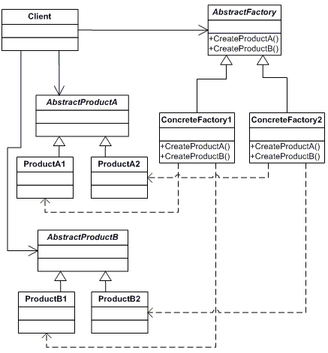
Abstract Factory: The Solutions
AbstractFactory
Declares an interface for operations that create abstract products
ConcreteFactory
Implements the operations to create concrete product objects: usually
instantiated as a Singleton
AbstractProduct
Declares an interface for a type of product object; Concrete Factories produce the concrete products
ConcreteProduct
Defines a product object to be created by the corresponding concrete factory

Slide 58
应用场景
抽象工厂模式可以帮助系统独立于如何对产品的创建、构成、表现。
抽象工厂模式可以让系统灵活配置拥有某多个产品族中的某一个。
一个产品族的产品应该被一起使用，抽象工厂模式可以强调这个限制。
如果你想提供一个产品的库，抽象工厂模式可以帮助暴露该库的接口，而不是实现。

Slide 59
应用注意点
隔离了客户和具体实现。客户可见的都是抽象的接口。
使得对产品的配置变得更加灵活。
可以使得产品之间有一定一致性。同一类产品可以很容易一起使用。
但是限制是对于新的产品的类型的支持是比较困难。抽象工厂的接口一旦定义好，就不容易变更了。
而这个场景的“代价”，或者是“限制”，是一个工厂中具体产品的种类是稳定的。

Slide 60
Abstract Factory体现了哪些思想？
Double ：Do not repeat
  对单一对象的创建代码可能会重复
  不同对象创建重复于同一个组合定义
封装（信息隐藏）：将对象创建抽象为单独职责，并隐藏创建细节
OCP、DIP、LSP
  提供抽象的创建接口定义
  产品组合的可扩展性
轻度违反：To be Explicit
  对象组合信息被置入ConcreteFactory，在Client代码中将无从知晓

Slide 61
Main Contents
Design Pattern Introduction
Information Hiding AND Strategy
Object Creation AND Factory, Factory Method, Abstract Factory, Singleton
Programming to Interface AND Iterator

Slide 62
Programming to Interfaces, not Implementations
“Connections that address or refer to a module as a whole by its name yield lower coupling than connections referring to the internal elements of another module”
  Collections
  Inheritance

Slide 63
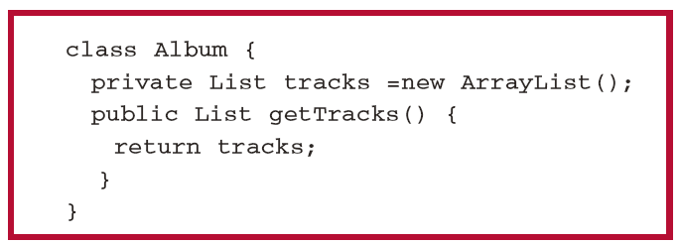
Single values VS a collection of values
Client代码对Album的侵入：
Album的tracks存储区
需要为该存储区建立一个访问接口
  Liskov: 区分功能抽象与控制抽象

Slide 64
Iterator Pattern
Intent
Provide a way to access the elements of an aggregate object sequentially without exposing its underlying representation.
Supports multiple traversals of aggregate objects.
Provides a uniform interface for traversing different aggregate structures (it supports polymorphic iteration).

Slide 65
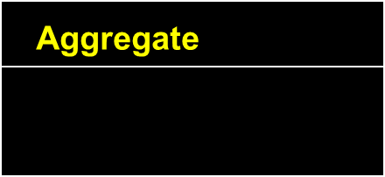
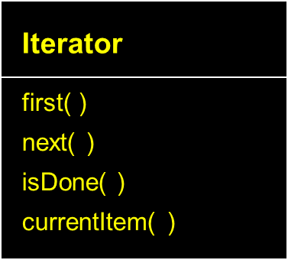



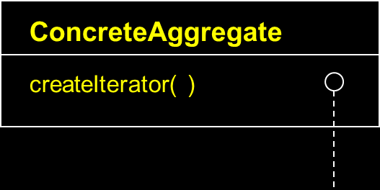


Iterator Pattern
Structure
createIterator( )
//client code
Aggregate myList = new ConcreteAggregate( );
Iterator itr = myList.createIterator( );

Slide 66
Iterator Pattern
Consequences
Programming to interfaces and Information Hiding
It supports variations in the traversal of an aggregate. For example, code generation may traverse the parse tree inorder or preorder. Iterators make it easy to change the traversal. Just replace the iterator instance with a different one.
Iterators simplify the Aggregate interface. Iterator’s traversal interface obviates the need for a similar interface in Aggregate.
More than one traversal can be pending on an aggregate.

Slide 67
Iterator Pattern体现了哪些思想？
Programming to interface
封装（信息隐藏）
  隐藏内部的复杂结构
ISP、SRP
  分离功能抽象与控制抽象
OCP、LSP、DIP
  实现访问机制的可变更性

